Slide 1
#1 Victoria is building a fence to use as a pasture for her horses. The pasture is in the shape of a rectangle. 50 feet 40 feet 40 feet 50 feet Part A Victoria needs to add the lengths of all 4 sides of the pasture. How many feet are there around the pasture? Show your work. Part B The fence comes in pieces that are 10 feet long. How many pieces of fence does she need to go around the pasture? Show your work. Part C The gate for the fence will cost $45. Victoria will put a lock on it that cost $37 and a sign that will cost $15. How much will it cost for these three items? Part D Victoria has $100 to spend on the gate, lock, and sign. Explain how to find out how much money she will have left after she buys the gate, lock, and sign.

Slide 2
#2 Raul is saving coins. He has 8 dimes, 3 quarters, and 12 nickels. Part A How many cents does Raul have in nickels? Show your work. Part B How many cents does Raul have in dimes? Show your work. Part C How many cents does Raul have in quarters? Show your work? Part D How many cents does Raul have all together? Show your work. | #3 Peta solved 34 + 29 using the expression 30 + 30+4 -1. Explain how Peta’s group of numbers can be the same as 34 + 29. Show your work using a number line.

Slide 3
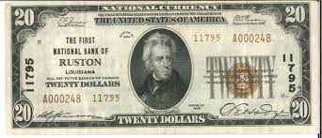

#4: The picture shows how much money James has in his wallet. Part A James wants to buy a toy car for $6. How much money will James have left if he buys the car? Explain how James can take $6 away from the money he has in his wallet. Part B James does not buy the toy car. He still has all of his money. James said that he needs $8 more dollars so that he can have $40. Is he correct? Explain your thinking.

Slide 4
#5 Jackie has 876 pennies. She used 678 pennies to buy some balloons. Part A How many pennies does Jackie have left? Explain your thinking and show your work? Part B If Jackie didn’t spend her pennies, how many more coins would she need to have 900 pennies? | #6 The teacher wrote the following problem on the board: 365 + = 445 Part A How can you use an open number line to solve for the missing number? Part B Show a different strategy that can be used to find out if your answer is correct?

Slide 5
#7 Hanna has dimes, nickels, and pennies. The table shows the number that she has of each type of coin. Part A Hanna makes groups of coins that are worth 38 cents. Describe one possible group of coins Hanna could make that is worth 38 scents. Part B Hanna’s grandmother gave her 3 dimes, 3 nickels, and 10 pennies. Write a new table to show the number she has of each type of coin. Part C Hanna wants to take 53 cents to Walmart tomorrow. What coin combination could she bring? Show your Work and share your thinking.
Coins | Number of Coins
Dimes | 10
Nickels | 20
Pennies | 30

Slide 6
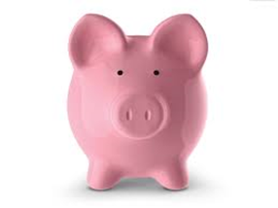
#8 Marco has been saving money in his piggy bank. So far he has 73 cents. Part A Write down a combination of coins that Marco could have. You must use at least 2 different coins. Part B Marco wants to use his money to buy pencils for school. How many pencils could he buy if they cost ten cents each? Part C Marco decided to save his money until he has 100 cents. What much does he need to save to reach 100 cents? Part D Is 100 cents the same as $1.00? Explain and show your work. | #9 Leena’s teacher writes the following math problem on the board. 64 + 32= Part A Could she solve the problem by writing 60+30+4+2? Explain your thinking and show your work? Part B Her friend Jadiah said the answer was 32. Can you recognize where she made her mistake? Share your thinking. Part C How could you use rods and cubes to illustrate this math sentence?

Slide 7

#10 Two sides of a piece of paper are 13 inches long. The other two sides are 8 inches long. Part A What is the distance around the piece of paper? Part B If there were two pieces of paper that were side by side, what would the total distance be? Part C If you took the one sheet of paper and folded it equally into 4 parts, what fraction would represent one of the parts?

Slide 8

#11 Lisa asked 3 friends how many baby teeth they had lost. Each friend had lost 7 teeth. Part A How many teeth had Lisa’s friends lost in all? Show your thinking. Lisa counted her own teeth. She has 12 teeth on top and the same number of teeth on the bottom. Part B What strategy could you use to find out how many teeth Lisa has in all? Show your thinking. | #12 Angeline is going to make clay. The bar graph shows the ingredients she’ll need. Part A How many cups will she need of each ingredient? Part B How many total cups of ingredients is Angelina going to use?

Slide 9
#13 The Rangers played 4 games against the Sliders in Soccer. The bar graph shows how many goals the Rangers scored in each game. Part A How many goals did the Rangers score in all 4 games? Show your work. Part B In the second game, the Sliders scored 1 less goal than the Rangers. How many goals did the Sliders score in Game 2? Show your work. Part C The Rangers wanted to score 25 goals in 4 games. How many more goals did the Rangers need to score to reach this? Show your work.

Slide 10
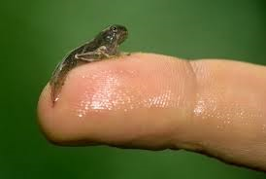
#14 Part A How many frogs are in each place? Part B What is the total amount of frogs in all? Part C How many frogs would need to be added to the total to have 40 frogs? Part D If 2 frogs could fit on 1 lily pad, how many lily pads would be needed for this place? | #15 One tadpole changed into a frog in 26 days. The second tadpole took 11 more days to change. The third tadpole took 10 more days than the second one to change. Part A How many days did it take the second tadpole to change into a frog? Part B How many days did it take the third tadpole to change into a frog? Part C Would it be better to use an inch, foot, or yard to measure a tadpole?
Place | Frogs
Lily Pads | 6+8
Log | 7+7
Tree | 5+9
Grass | 4+10

Slide 11
#16 Maya is growing sunflowers. She measures them every day with a ruler. The picture shows the height in inches of her smallest flower today. Part A How tall is her smallest sunflower? Explain your answer. Part B Her smallest flower was only 4 inches tall when Maya started measuring it. How much has it grown since then? Show your work. Part C When Maya measured the tallest flower after one month, it was 24 inches tall. It grew 13 inches in the next month. How tall was the flower when she measured it again? Part D Maya has a tulip that measures 29 inches. How much taller is the tallest sunflower than the tulip in Part C?

Slide 12
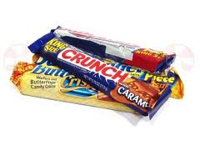
#17 John builds a fence around his garden. The garden is in the shape of a rectangle. The number sentence is 6+6+?+?=20 Part A What number does each “?” represent in the number sentence? Show your work. John makes a second garden. The number sentence is 7+7+?+?=24 Part B What number does each “?” represent in this number sentence? Show your work. | #18 Daria had $5. Yesterday, she bought a candy bar and soda for $1.25 each. Part A How much money did Daria spend? How do you know? Part B How much money does Daria have left? Part C Daria was paid $7 to babysit her cousin. How much money does she have now? Show your thinking.

Slide 13
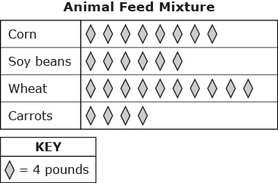
#19 The picture graph shows the amounts of corn, soy beans, wheat, and carrots that a farmer uses to make animal feed. Part A What is the total value of each ingredient? How many more pounds of corn does the farmer use than soy beans? Show your work. Part B The farmer wants to add 28 pounds of pumpkins to the animal feed. Draw a row of shapes that should be added to the picture graph to show how many pounds of pumpkins are in the mix. Part C Create a bar graph using the data from the picture graph.

Slide 14
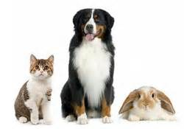
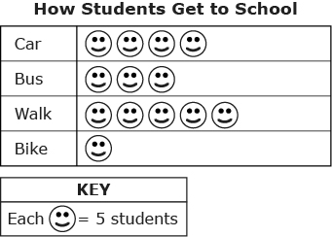
#20 Sofia made a picture graph to show how the students in her grade get to school each morning. Part A How many students arrived by car, bus, walked, or biked? How can your prove your thinking? Part B How many more students walk to school than ride the bus? | #21 Kelly surveyed 10 of her friends to find their favorite pet. Two people said rabbits. Three people said cats. Five people said dogs. Kelly is going to make a graph to show her results. Part A Draw a pictograph to illustrate the data from Kelly’s survey. Part B Draw a bar graph to illustrate the data from Kelly’s survey.

Slide 15
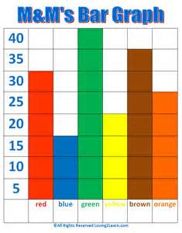
#22 The bar graph shows the number of colored M&M’s in a large bag. *have students to draw this graph in their journals Part A What scale was used on this M&M Bar Graph? How would a pictograph look if the scale was 10? Part B What is the value of each color on the graph? Part C How many M&M’s are there altogether? What strategy can you use to prove your thinking?

Slide 16
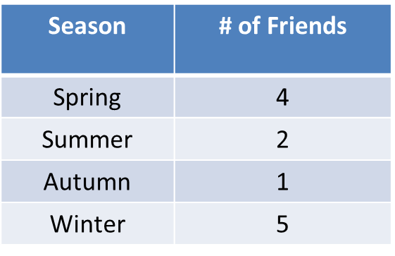
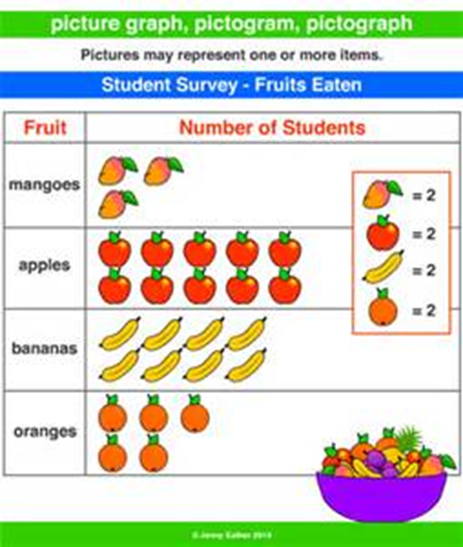
#23 Lin asked some of her friends what season of the year they were born. Part A Make a picture graph to display the data with a title and key for your graph. Part B Make a bar graph to display the data. | #24 Part A Create a bar graph to represent the data. Part B How many more students like apples compared to mangoes?

Slide 17
#25 The graph below shows the number of each type of muffin sold at a bakery one morning. Part A What numeric scale was used for the number of muffins sold? Create your own bar graph using the amount of apples, lemons, and bran muffins sold. Part B What is the difference between the number of apples and bran muffins sold? How can you prove your thinking? Part C How many muffins in all were sold in one morning?

Slide 18
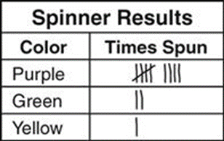
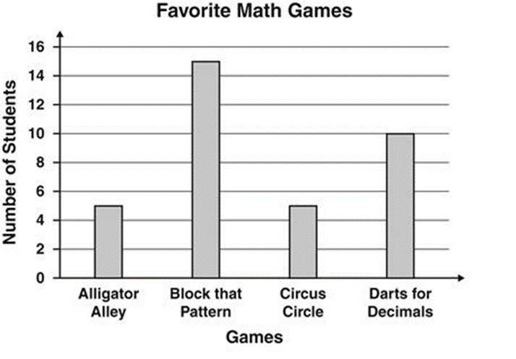
#26 Part A If each tally mark represents a scale of 2, what is the value for each color on the graph? Part B If each tally mark represents a scale of 5, what is the value for each color on the graph? | #27 Part A What is the number of students that chose each game? Part B What is the total number of students counted in this survey? Part C How many more students liked Block That Pattern than Circus Circle?

Slide 19
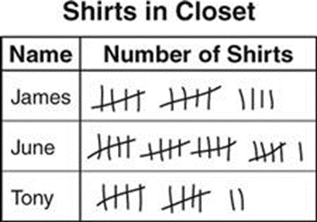
#28 This graph shows the number of shirts that students have in their closet. Part A Create a pictograph to represent the tally marks. What is a numeric scale to use for your graph? Part B Create a bar graph using the data from the tally marks. What is a numeric scale to use for your graph? Can you use a different one from Part A? Part C If each tally mark represented 2 shirts, what would each student have?

Slide 20
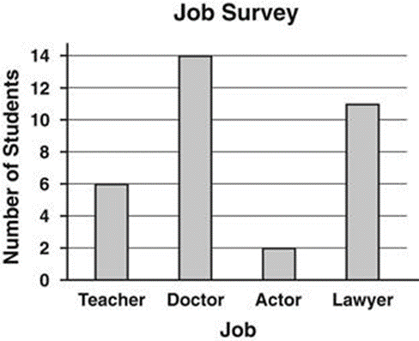
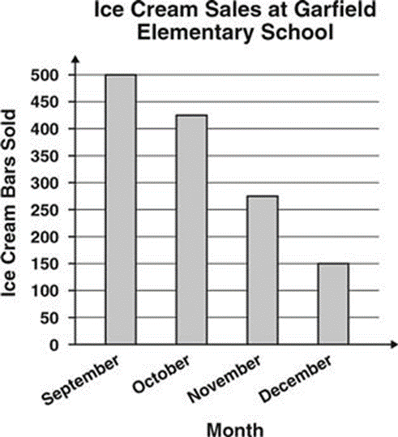
#29 Part A How can you determine the total number of students who took this survey? Part B Which two job positions together would have more student votes than that of a doctor? Prove your thinking. | #30 Part A How many ice cream bars were sold in September and October? Part B What is the difference of ice cream bars sold in September and December?

Slide 21
#31 A diagram of a shopping center is shown. Part A One part of the shopping center is the vision store. What fraction of the shopping center is the vision store? Explain your answer. Part B The movie theater uses 3/8 of the shopping center. How many parts with a size of 1/8 is the theater? Part C If the movie theater uses 3/8 of the shopping center and the vision center uses one part, what fraction represents the remainder of the shopping center. Explain your answer in two different ways.

Slide 22

#32 A shopper visits the restaurant. The clock shows the time the shopper entered the restaurant. The shopper stayed for 45 minutes. What time did the shopper leave? Show your work. Explain your answer. | #33 Construct a diagram of a shopping center divided into 6 equal parts and labeled with: A restaurant that uses 1/6 of the space A toy store that uses ½ of the space A shoe store that uses more space than the restaurant, but less space than the toy store.

Slide 23
#34 Cory and Allison have the same size poster board to use for a project. They each divided their poster boards into equal parts as shown. Cory’s Poster Board Allison’s Poster Board Part A Write a fraction to represent the size of one part of Allison’s whole poster boar. Explain how you got your fraction. Part B Allison says that two parts of her poster are equal to one part of Cory’s poster. Use what you know about equivalent fractions to explain or show if Allison is correct. Part C Cory and Allison both colored 3 parts of their posters blue. Cory says that they colored equal parts of their posters. Is Cory’s statement correct? Use what you know about comparing fractions to explain your answer.

Slide 24
#35 Juan, Kiera, and Ben share a bookcase. Juan owns 2/8 of the books, Kiera owns 5/8 of the books, and Kate owns 1/8 of the books on the bookcase. They have 24 books in all. Part A How many books does Juan own? Show and explain your work. Part B How many books does Kiera own? Show and explain your work. Part C Does Ben own more books or fewer books than Juan? Show and explain your work. | #36 Draw a number line that stars at 0 and ends at 1. Place the fractions 3/8, 5/8, and 1/8 on this number line. Look at your number line. Which fraction is the largest?

Slide 25
#37 Alyssa has a rectangular wooden board. She cuts off 1/6 of the board from the left side and 2/6 of the board from the right side. Part A Draw a picture that shows 1/6 of the board shaded. Part B Draw a picture that shows the total parts of the board that Alyssa cuts off. Part C Which is larger, 1/6 or 2/6? Use either <, >, or = to compare the fractions. Explain your comparison. Part D What fraction of the board does Alyssa have left? Show and explain your thinking and work. | #38 A teacher draws a number line on the board from 0 to 1 and divides the number line into equal sections. Some of the sections are labeled with a letter. 0 A B C D E 1 Part A How many equal sections are there between 0 and 1? Write the fraction that represents the location of A on the number line. Part B Using 0 as the starting point, write two fractions that could represent the location of C on the number line. Explain your work. Part C The teacher asked a student to locate the point that represents 4 parts our of the total. What fraction represents this point? Part D Using the number line, what is another way to write the number 1?

Slide 26
Constructed Response: Fractions Karina is painting a fence as shown. The fence is divided into equal parts. The shaded area represents how much of the fence Karina has painted. Part A Draw a number line from 0 to 1 and divide it into the same number of equal parts as the fence. Make a point on your number line that shows the fraction of the fence Karina has painted. Label the point with the fraction that it represents. Part B Write a fraction that represents the whole fence. Part C Tammy is painting a fence with the same area as Karina’s fence, but her fence is divided into 6 equal parts. She has painted 5 parts of her fence. Tammy says that she and Karina have painted equal fractions of each fence. Is Tammy’s statement correct? Explain and show how you know. Part D How many eighths are equivalent to ½ of Karina’s fence? How many sixths are equivalent to ½ of Tammy’s fence?

Slide 27

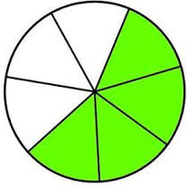

Extension 1 The figure shows a rectangle that has been divided into equal parts. Part A Draw a number line from 0 to 1. Divide the number line into the same number of equal parts as shown in the figure. Then, place a point on the number line to show what the value of the shaded part represents. Part B Write an addition sentence with a numerator of 1 that is equivalent to the fraction of the shaded parts shown. Part C Fill in the box with a <,>, or = sign. Explain your answer using a model. 3/4 3/8 | Extension 2 Ms. Barr drew two circles on the board. She split both circles into 6 equal parts. The she shaded in some pieces on each circle. Part A Write the two fractions that the circles show. Use the symbol <, >, = to compare your fraction. Explain your answer. Part B Draw a circle with 6 equal parts that show a fraction that is greater that both of Ms. Barr’s fractions. Explain your thinking.

Slide 28
Constructed Response: Review LeBron, Rita, and Samuel went to a circus. They saw that the floor of the circus tent was a large rectangle divided into equal parts. Part A Draw a rectangle and divide it into more than 3 equal parts. Shade one of the equal parts of your rectangle. Write a fraction that shows what part of the whole rectangle you shaded. Explain your answer. Part B Samuel counted twice as many elephants as tigers in the circus. He counted a total of 24 elephants and tigers in all. How many tigers did Samuel count? Show and explain how you got your answer. Part C One of the clowns wore a shirt with colored quadrilaterals. Rita said she like the red quadrilaterals that was not a parallelogram. Draw a shape that could represent the shape Rita liked. Part D LeBron paid $14 for his ticket and $6 per ticket for Samuel and Rita. What was the total cost of the tickets? Show your work.

Slide 29
Extension 1 Look at the rectangle. 8 cm 5 cm Part A What is the area of the rectangle in square centimeters? Label your answer and show your work. Part B Draw a rectangle and divide it into 4 equal parts. What is the relationship of the area of one part to the area of the entire rectangle? Part C In square centimeters, what is the area of one of the parts from the divided rectangle in Part B? Show your work. | Extension 2 Carolyn collected some insects for a science project. The length, in inches, of the insects are listed below. 1/8, ¼, ¼, 5/8, ¾, 1/8, 3/8, 3/8, 5/8, 3/8, ¼ Part A Make a line plot of the data. Include labels and a title.

Slide 30
Constructed Response: Review Jana put her train set on the top of a table. The table is 6 feet long and 4 feet wide, as shown. 6 feet 4 feet Part A What is the area of the table? Show your work and explain how you got your answer. Part B What is the perimeter of the table? Show your work and explain how you got your answer. Part C Jana needed more room for her train set. She set up another table next to the table shown. The new table is 4 feet wide and has a perimeter of 24 feet. What is the sum of the areas of the two tables together? Show your work.

Slide 31
Constructed Response: Review Henry and Allison each baked a pasta pie. Henry’s pie was 9 inches long and Allison’s was 8 inches long. Each pasta pie was cut into 6 equal sections. Henry’s Pasta Pie Allison’s Pasta Pie Part A Henry gave one piece of his pasta pie to a friend. What fraction of his pasta pie did Henry give away? Explain your answer. Part B Allison also gave one piece of her pasta pie to a friend. Allison says that she and Henry both have the same amount of pasta pie left. Is Allison correct? Explain your answer.

Slide 32
Extension 1 Alyssa has a rectangular wooden board. She cuts off 1/6 of the board from the left side and 2/6 of the board from the right side. Part A Draw a picture that shows 1/6 of the board shaded. Part B Draw a picture that show the total parts of the board that Alyssa cuts off. Part C Which is larger 1/6 or 2/6? Show how you know. Part D What fraction of the board does Alyssa have left? | Extension 2 Melissa travels 4 miles on her bike each day. Nadine travels 5 miles on her bike each day. Part A How many days will it take for Melissa to travel 100 miles on her bike? Prove your thinking. Part B How many days will it take for Nadine to travel 100 miles on her bike? Prove your thinking.

Slide 33
Constructed Response: Review Dwight and Samantha are building brick towers as shown. The shaded parts show the number of bricks Dwight and Samantha each painted. Dwight Samantha Part A Write a fraction to show the part of the tower Dwight has painted. Write a fraction to show the part of the tower Samantha has painted. Compare the two fractions using the symbols >, =, or <. Part B Each brick weighs 6 pounds. What is the total weight of each tower. How can you prove your thinking?

Slide 34
Extension 1 Pierre was paid $8.00 each time he mowed the lawn. Part A In June, he mowed 6 lawns. How much did he earn? Part B In July, he mowed 8 lawns. How much did he earn? Part C By the end of summer, he mowed the lawn 20 times. How much did he earn? | Extension 2 Pierre and his brothers want to buy a surprise gift for his mother. They boys have a total of $27.00. Part A Write a fraction to express the equal amount each son should pay. Part B Draw a picture that shows your thinking from Part B. How can you prove your thinking?

Slide 35
Extension 1 Lin asked some of her friends what season of the year they were born. The table shows her data. Part A Make a picture graph to display the data. Be sure to have a title and key for your graph. Part B What fraction of Lin’s friends were born in autumn? Explain your answer. Part C What fraction of Lin’s friends were NOT born in autumn. Explain your answer.
Season | # of Friends
Spring | 4
Summer | 2
Autumn | 1
Winter | 5

Slide 36
Extension 1 Shelly has $6.00. She wants to buy a goldfish and the supplies needed to take care of it. Part A How much did the goldfish and bowl cost? How much money did she have left? Part B How much did the fish food and rocks cost? Shelly said she should have some money left over. Is she correct? How can you prove your thinking? | Extension 2 Shelly and her mom had a snack while they were shopping. Pretzels cost $1.75 and drinks cost $1.25. Part A If they each had a drink and a pretzel, what was the total bill for Shelly and her mom? Part B Shelly’s mom paid the bill using $10.00. Should she get change back? How can you prove your thinking?
Goldfish | $3.00
Fish food | $1.00
Bowl | $1.50
rocks | $0.50

Slide 37
Extension 1 Jordan bought 9 boxes of pencils. Each box had 6 pencils. Part A How many pencils did Jordan buy? Part B Jordan gave 12 pencils to her sister. Jordan then divided the rest of the pencils equally between 7 friends. Write an equation that can be used to find the number of pencils each friend got. Use a letter to stand for the number of pencils each friend got. Part C How many pencils did each friend get? Show your work or explain your answer.

